Slide 1
CLASS WORK
PRINCIPLES OF ACCOUNTING

Slide 2
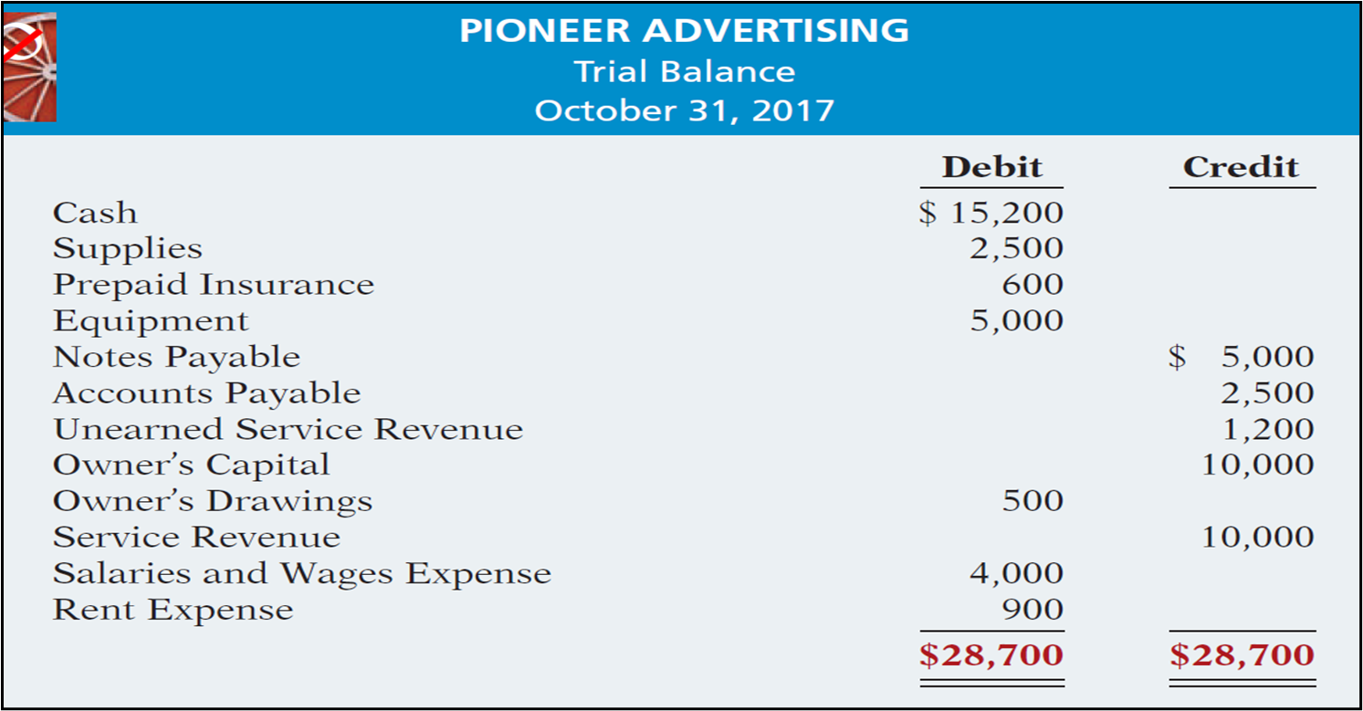

Slide 3
Pioneer Advertising purchased supplies costing $2,500 on October 5. Pioneer recorded the payment by increasing (debiting) the asset Supplies. This account shows a balance of $2,500 in the October 31 trial balance. An inventory count at the close of business on October 31 reveals that $1,000 of supplies are still on hand.
On October 4, Pioneer Advertising paid $600 for a one-year fire insurance policy. Coverage began on October 1. Pioneer recorded the payment by increasing (debiting) Prepaid Insurance. This account shows a balance of $600 in the October 31 trial balance. Insurance of $50 ($600 ÷ 12) expires each month.
For Pioneer Advertising, assume that depreciation on the equipment is $480 a year, or $40 per month.
Pioneer Advertising received $1,200 on October 2 from R. Knox for advertising services expected to be completed by December 31. Unearned Service Revenue shows a balance of $1,200 in the October 31 trial balance. Analysis reveals that the company performed $400 of services in October.
: In October Pioneer Advertising performed services worth $200 that were not billed to clients on or before October 31.
Pioneer Advertising signed a three-month note payable in the amount of $5,000 on October 1. The note requires Pioneer to pay interest at an annual rate of 12%.
Pioneer Advertising paid salaries and wages on October 26; the next payment of salaries will not occur until November 9. The employees receive total salaries of $2,000 for a five-day work week, or $400 per day.

Slide 4
REQUIREMENTS
1. Make adjustments (Journal entries).
2. Post and make an adjusted Trial balance as on 31st Dec,2017
3. Prepare 3 first Financial Statements

